Slide 1
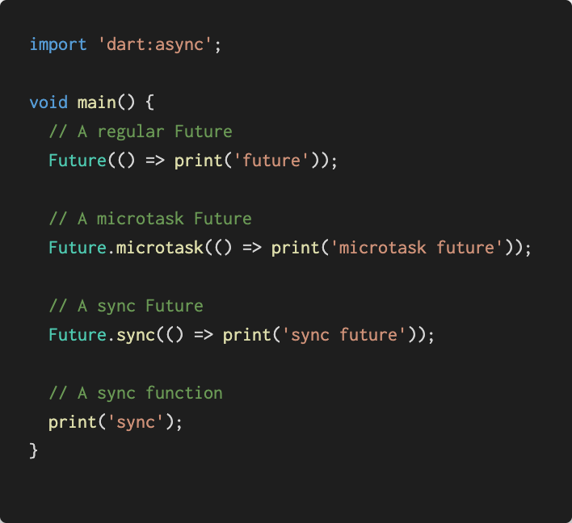
Microtask Queue
Console
() => print('microtask future')
sync future
sync
microtask future
future
Event Queue
() => print('future')

Slide 2
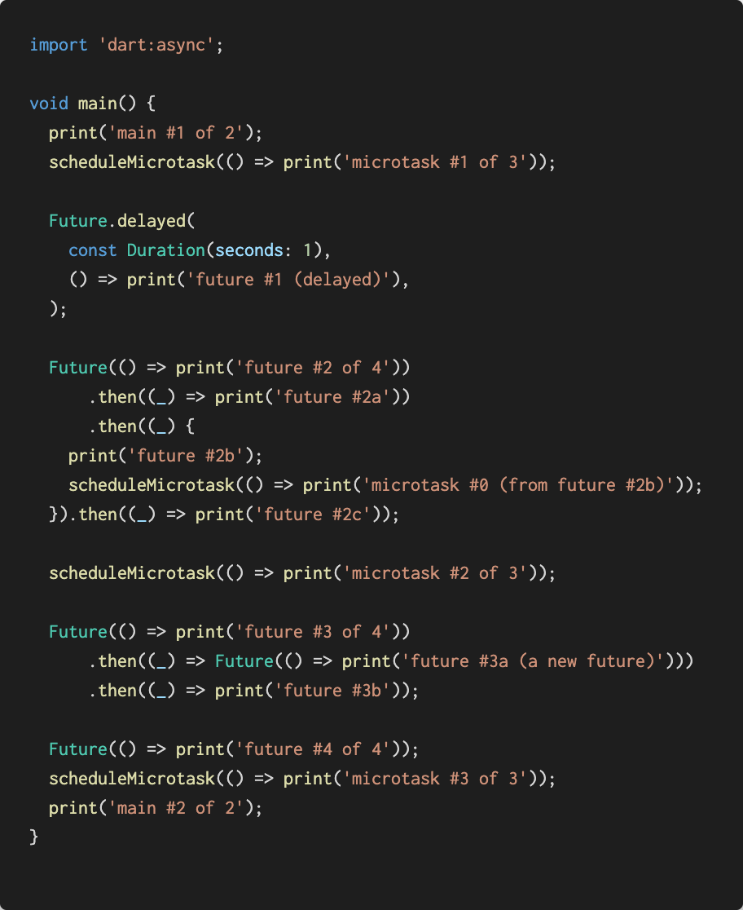
Microtask Queue
Console
() => print('microtask #1 of 3')
main #1 of 2
() => print('microtask #2 of 3')
main #2 of 2
() => print('microtask #3 of 3')
microtask #1 of 3
() => print('microtask #0 (from future #2b)')
microtask #2 of 3
microtask #3 of 3
future #2 of 4
future #2a
future #2b
Event Queue
future #2c
microtask #0 (from future #2b)
() => print('future #1 (delayed)')
1s
future #3 of 4
() => print('future #2 of 4')
future #4 of 4
() => print('future #3 of 4')
future #3a (a new future)
future #3b
() => print('future #4 of 4')
future #1 (delayed)
() => print('future #3a (a new future)')
Notes:
https://web.archive.org/web/20170704074724/https://webdev.dartlang.org/articles/performance/event-loop

